Slide 1
Adopt-a-well

Slide 2
Adopt-a-Well
Accessibility of the platform

Slide 3
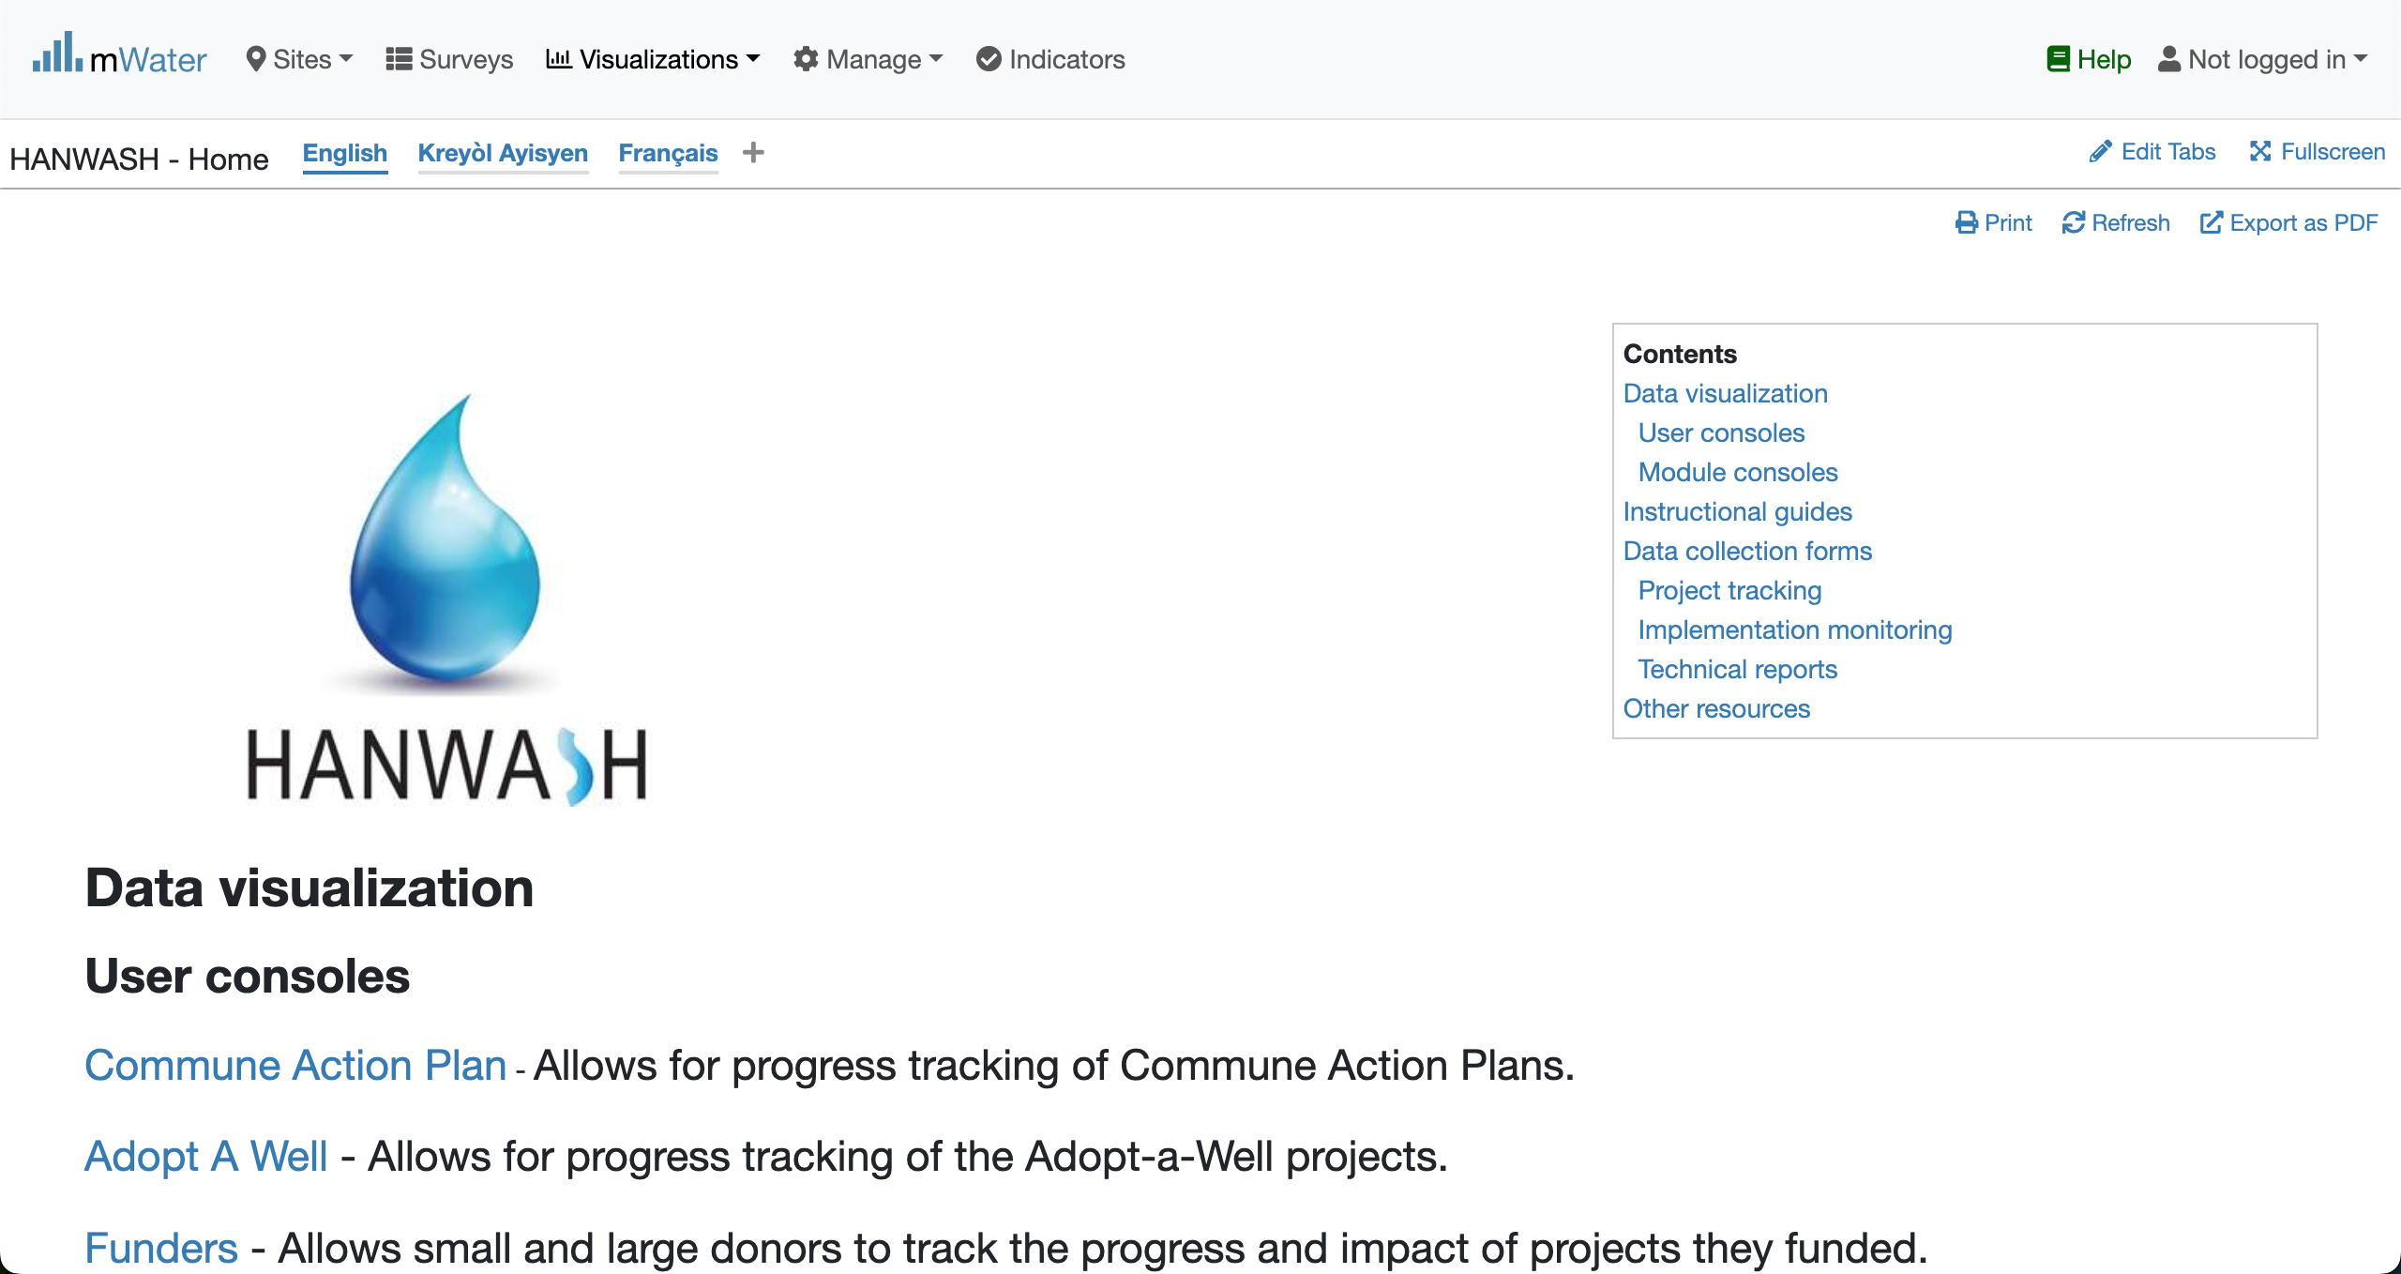
Hanwash HOME
URL LINK : http://go.mwater.co/hanwash

Slide 4
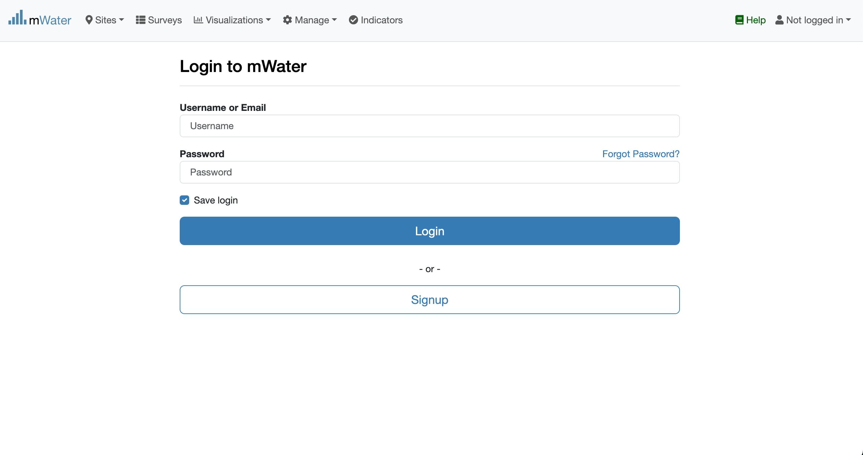

Access The COnsole & Login process
Click on the Adopt-A-Well url link
Not Logged in
Please enter your Credentials

Slide 5

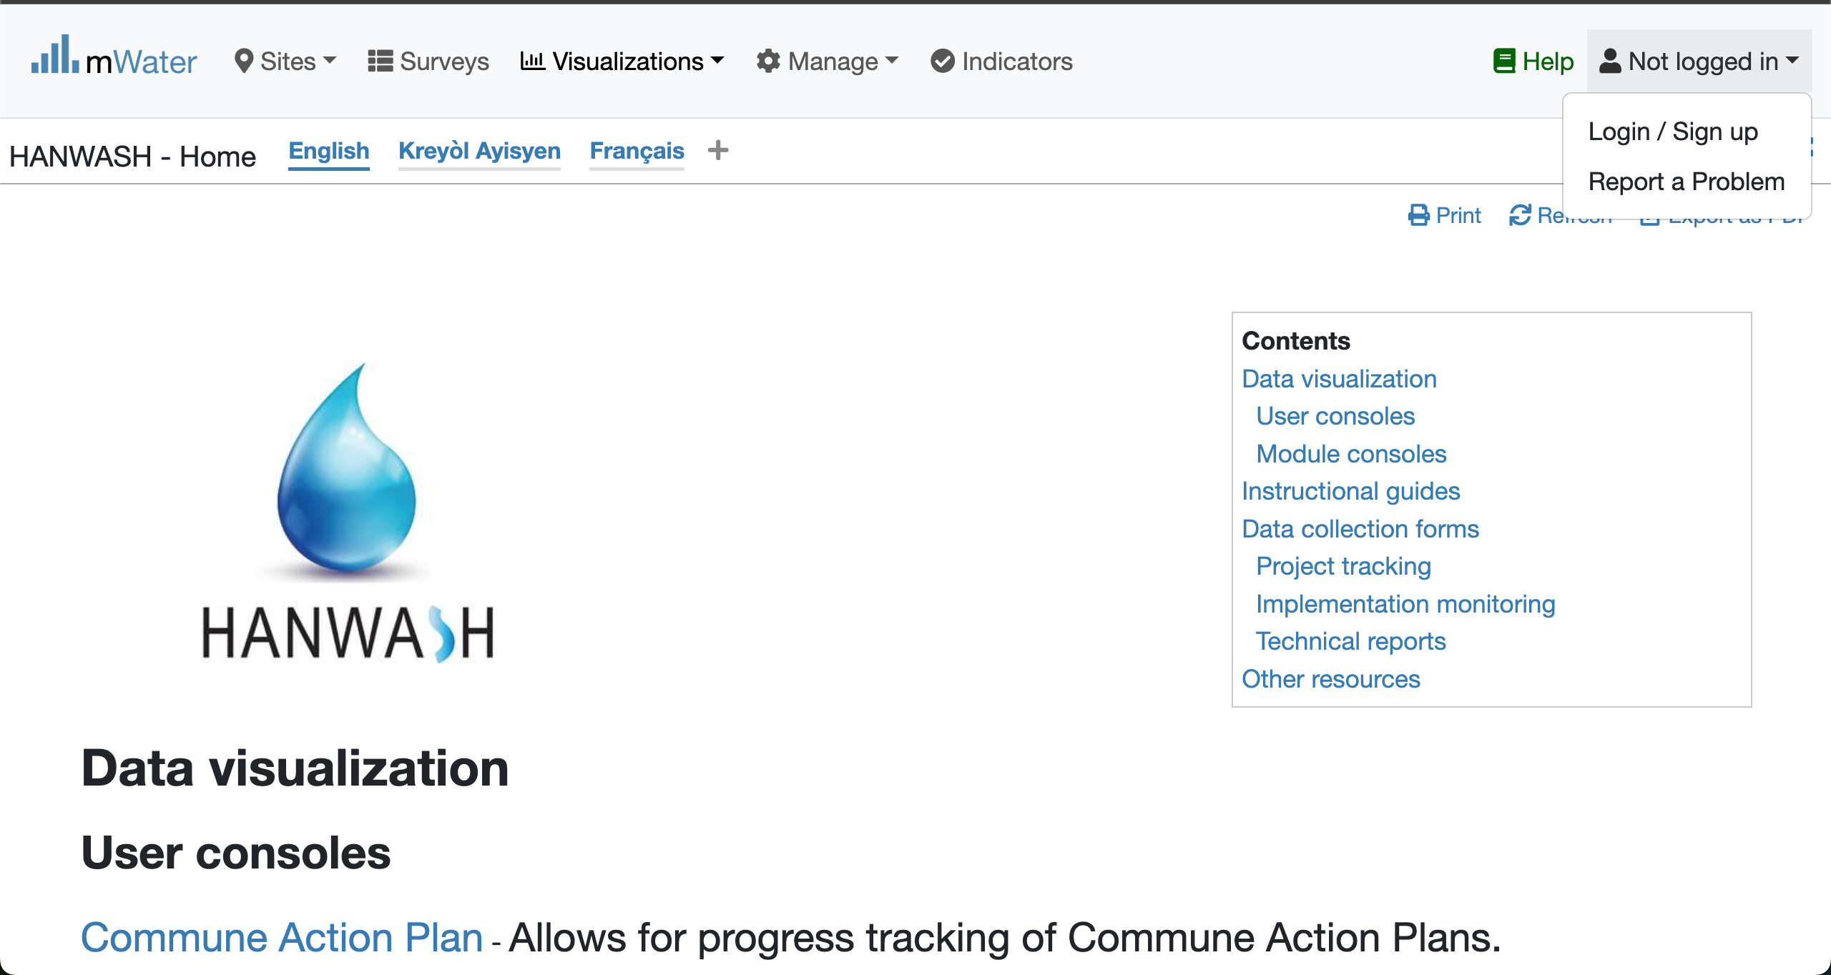

Login Process (2nd scenario)
Click to Login or Signup
Please Click on this selection box
Please enter your Credentials

Slide 6
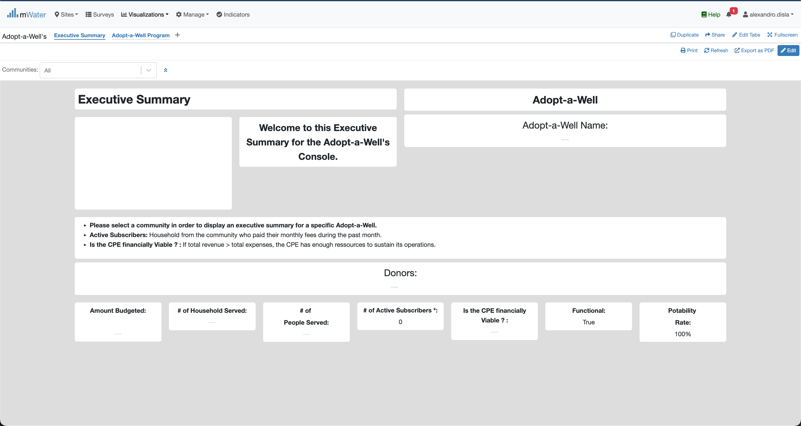
Adopt-a-well Console overview

Slide 7
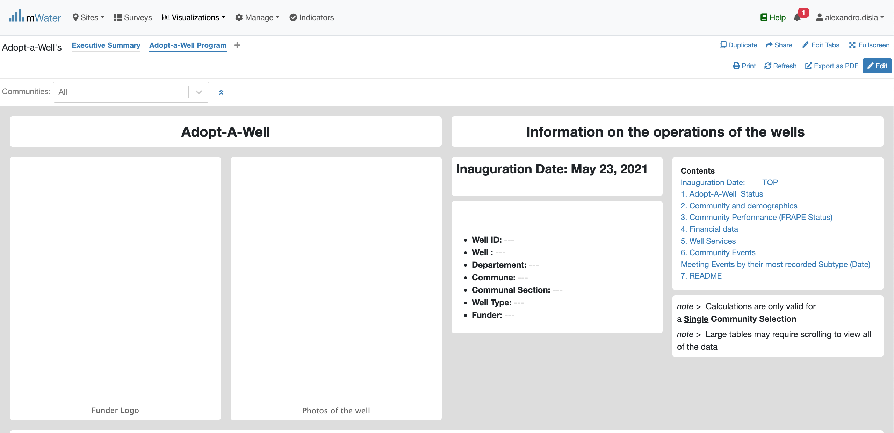
Adopt-a-well Console overview

Slide 8
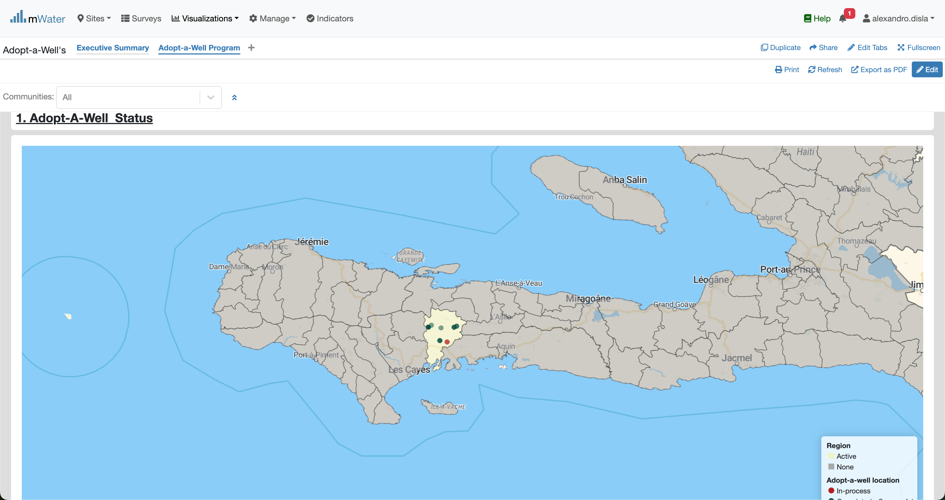
Adopt-a-well Console overview

Slide 9
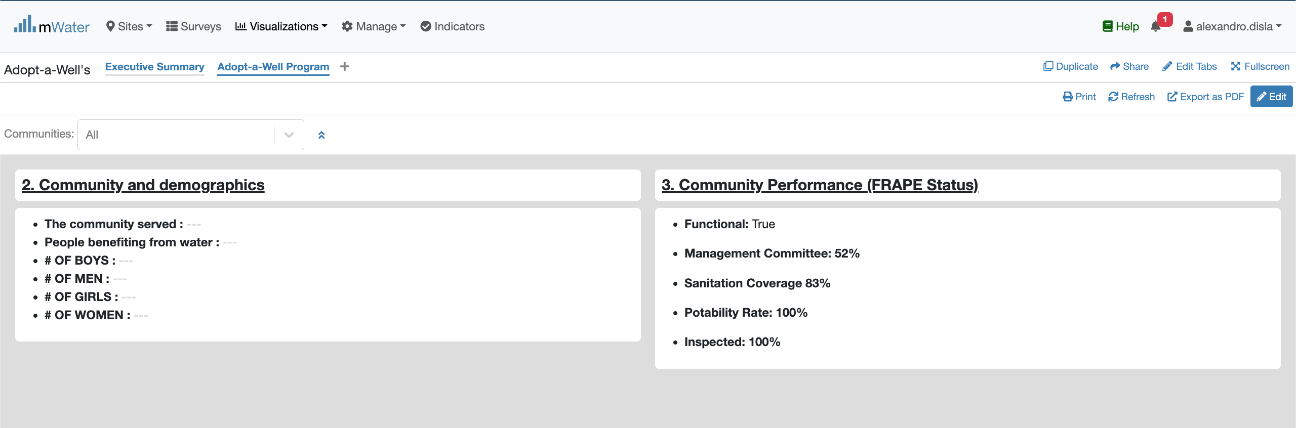
Adopt-a-well Console overview

Slide 10
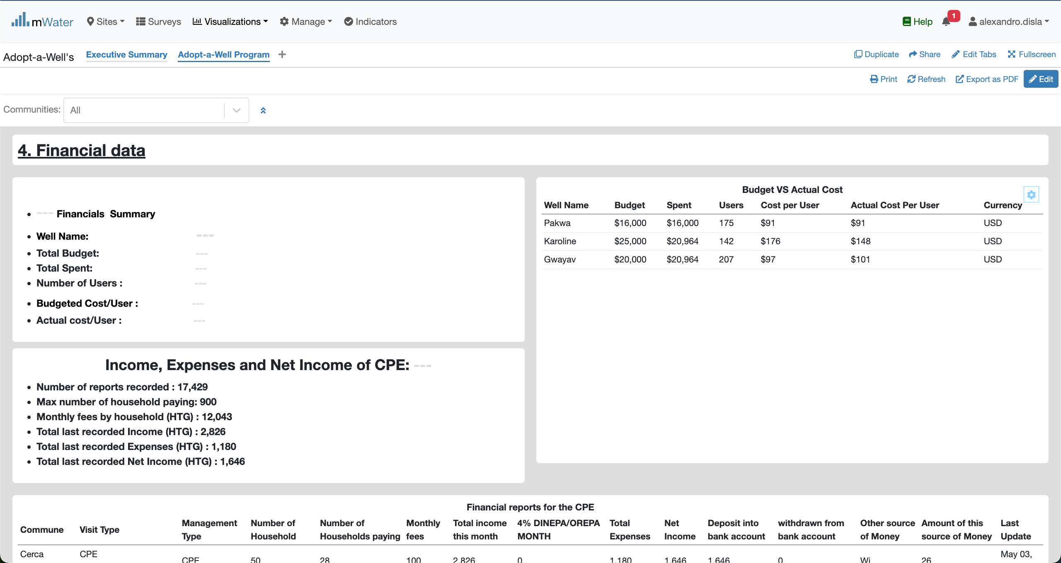
Adopt-a-well Console overview

Slide 11
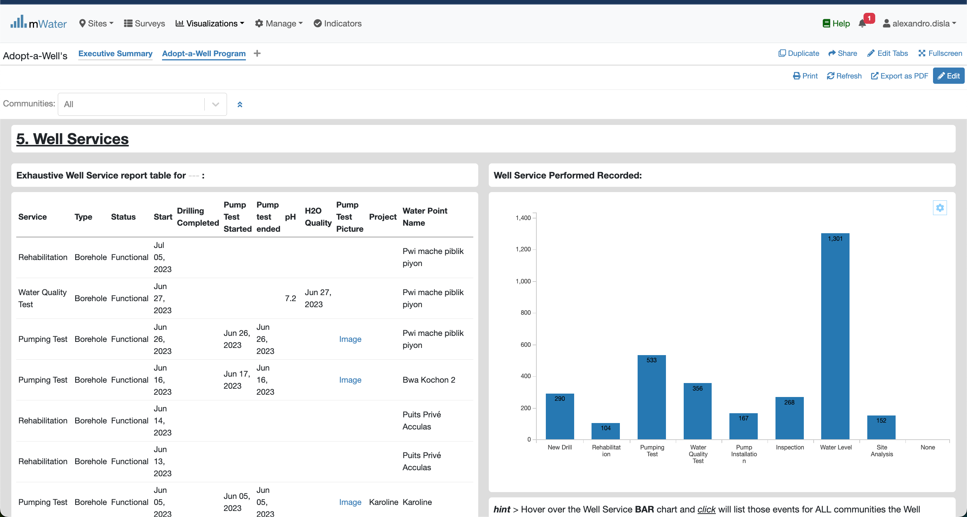
Adopt-a-well Console overview

Slide 12
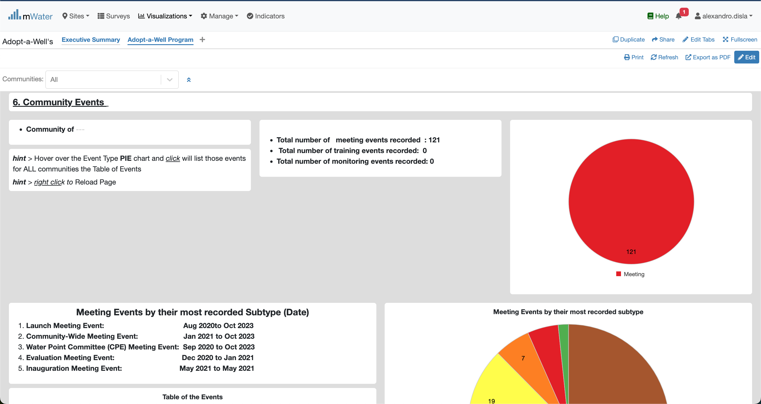
Adopt-a-well Console overview

Slide 13
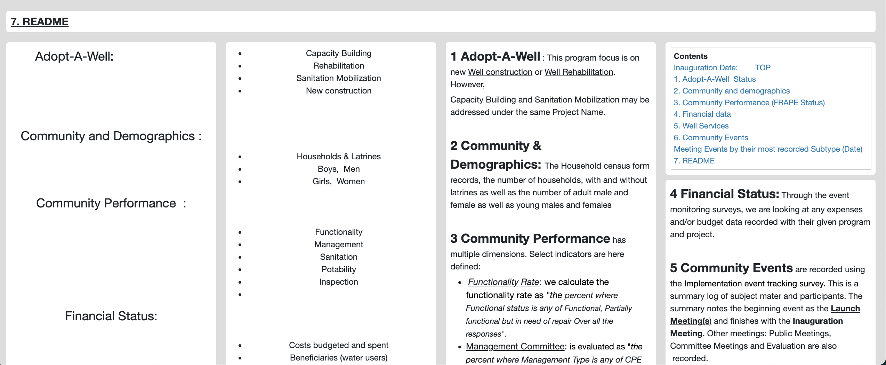
Adopt-a-well Console overview

Slide 14
Functionalities
Functionalities available in the console

Slide 15
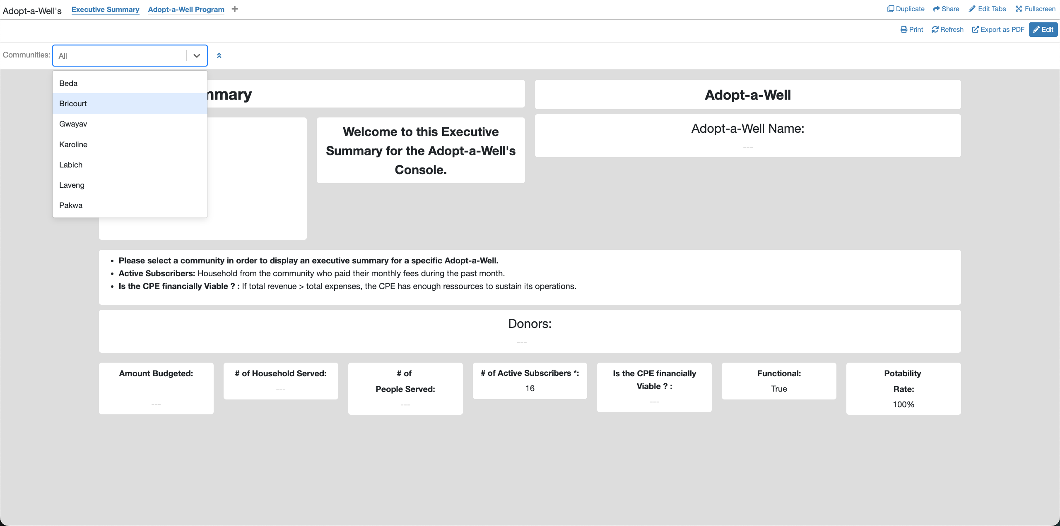
Executive Summary – Quick Filters
Access the communities
Select a community

Slide 16
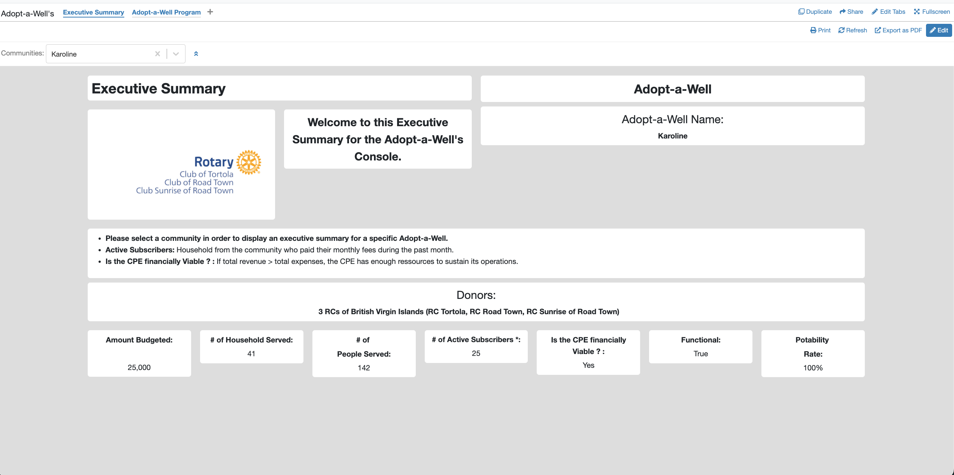
Executive Summary
Information Box

Slide 17
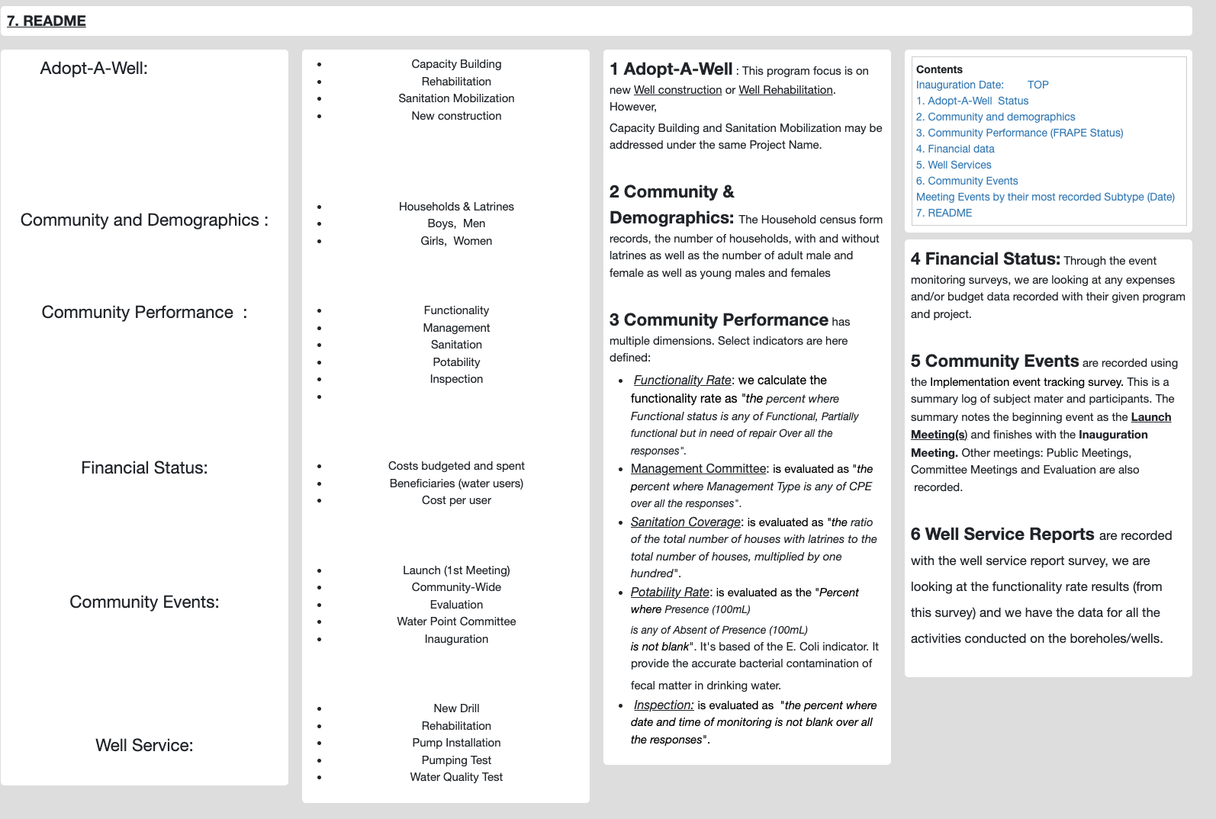
Readme section
Table of Content (Navigation)
Sections
Subsections
Definitions

Slide 18
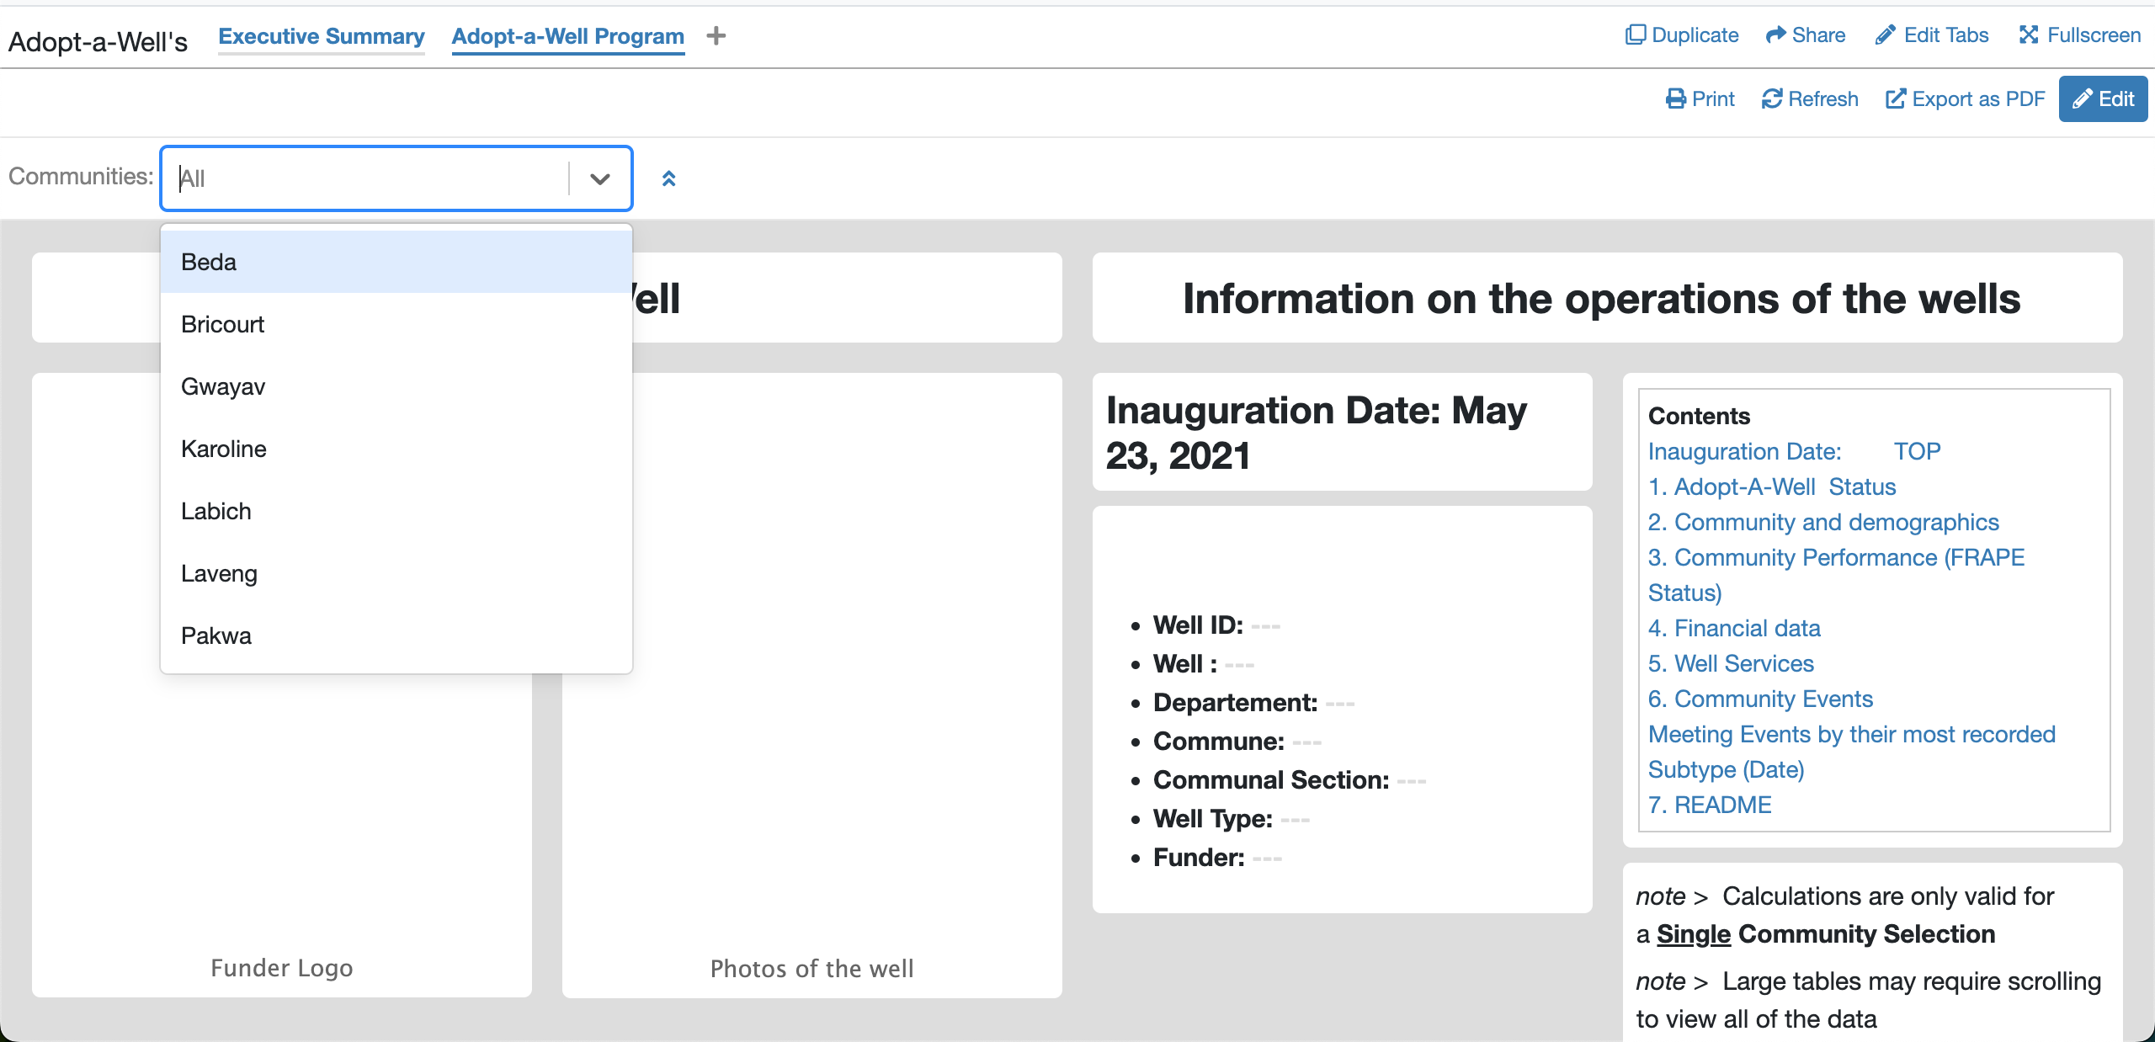
Quick filters
Open the Communities
Please select a community

Slide 19
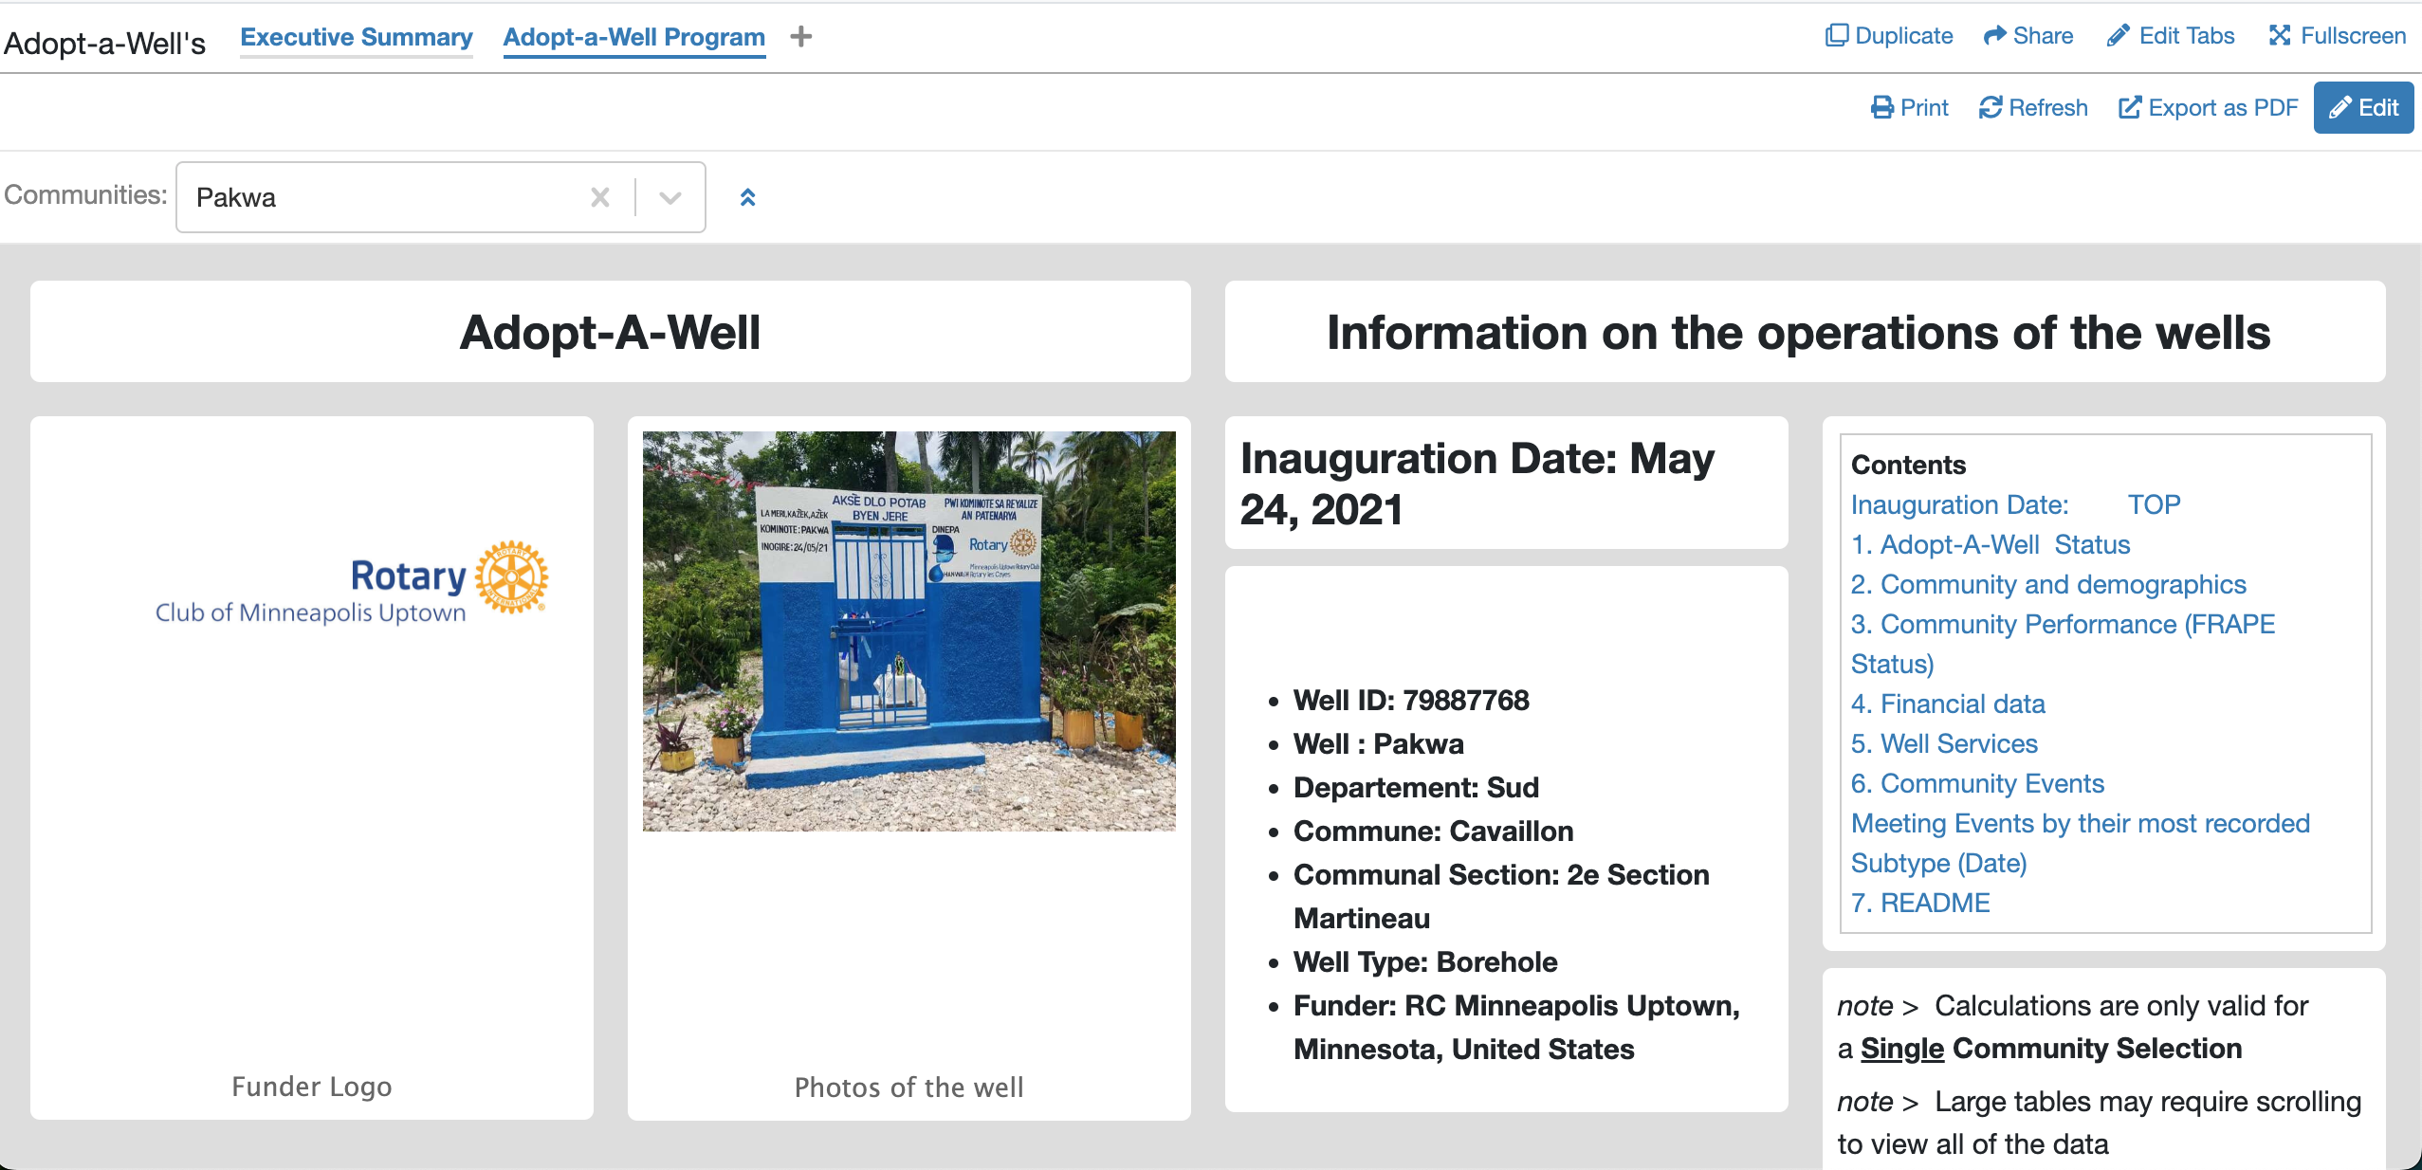
1SeCtion
The community of Pakwa is selected
Table Of Content
Primary informations
Picture of the well and the funder logo

Slide 20
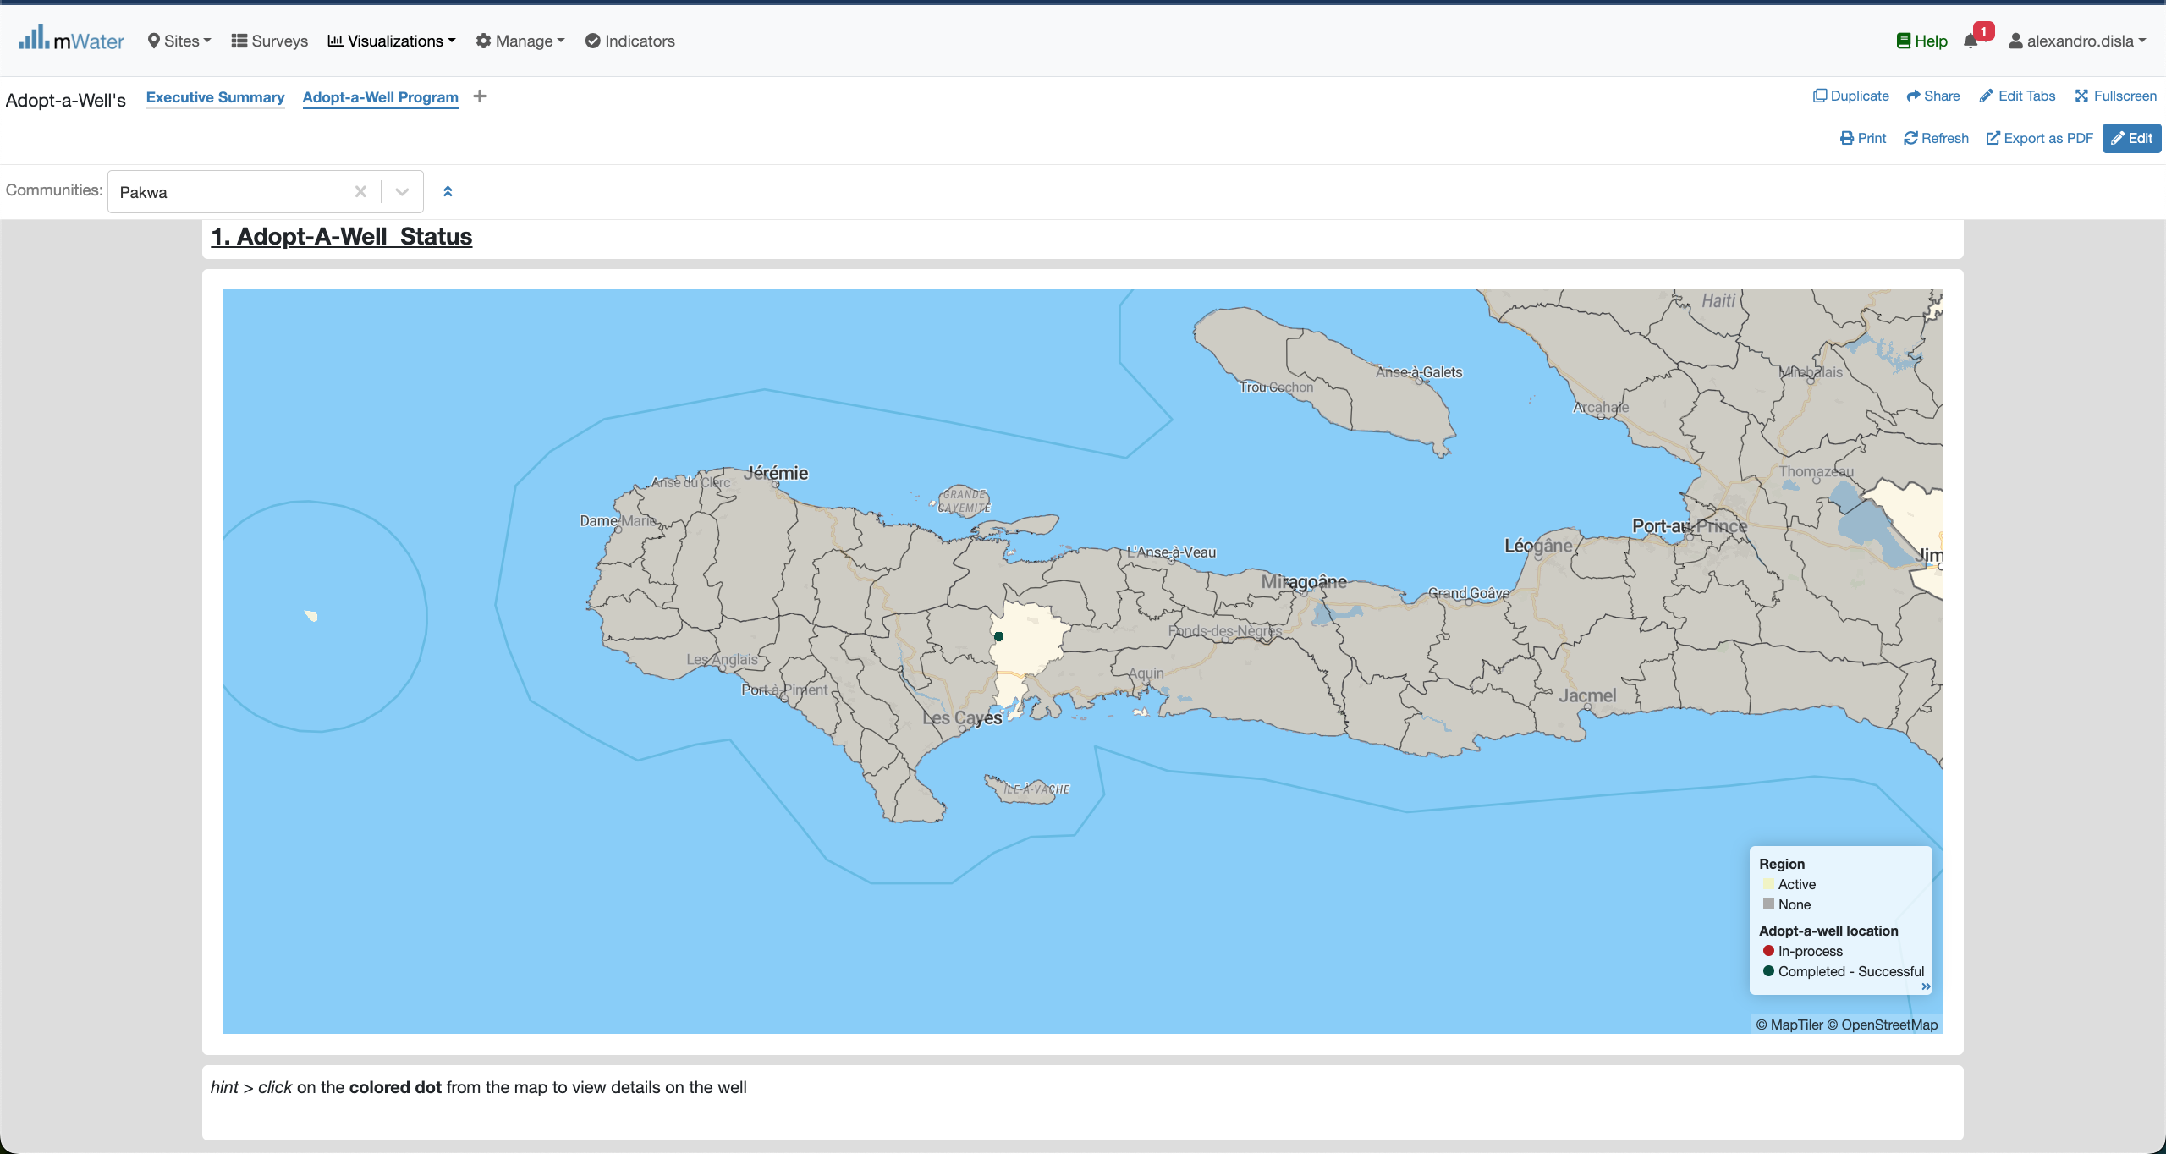
2 SeCtion - MAP
The Area of the active Adopt-a-Well program
The location of the Well and his status
You can click on this point

Slide 21
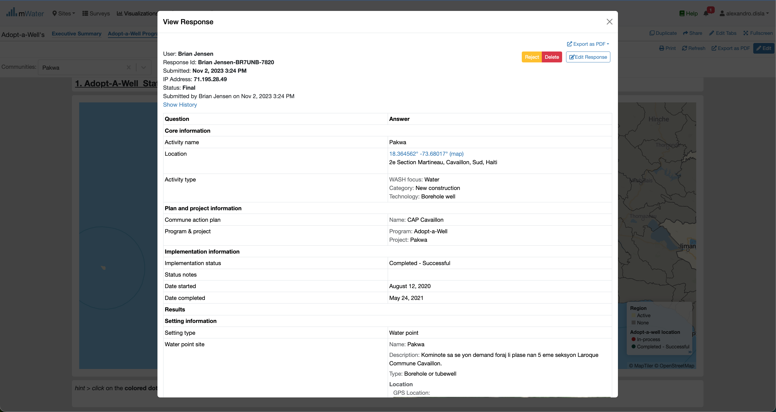
2 SeCtion – MAP Interaction
Modal will cover the page with the response for the well selected on the map.

Slide 22
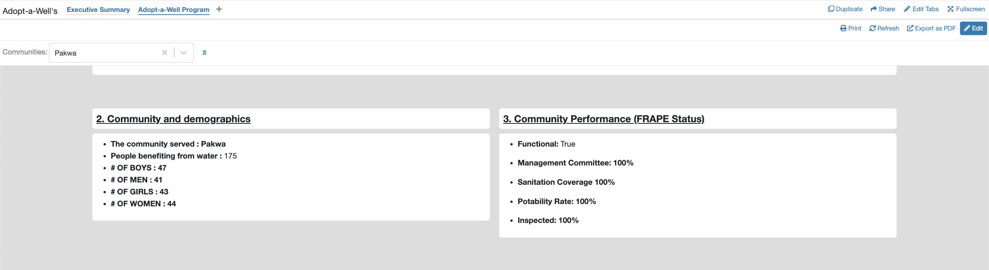
3SeCtion – Demographics and Performance

Slide 23
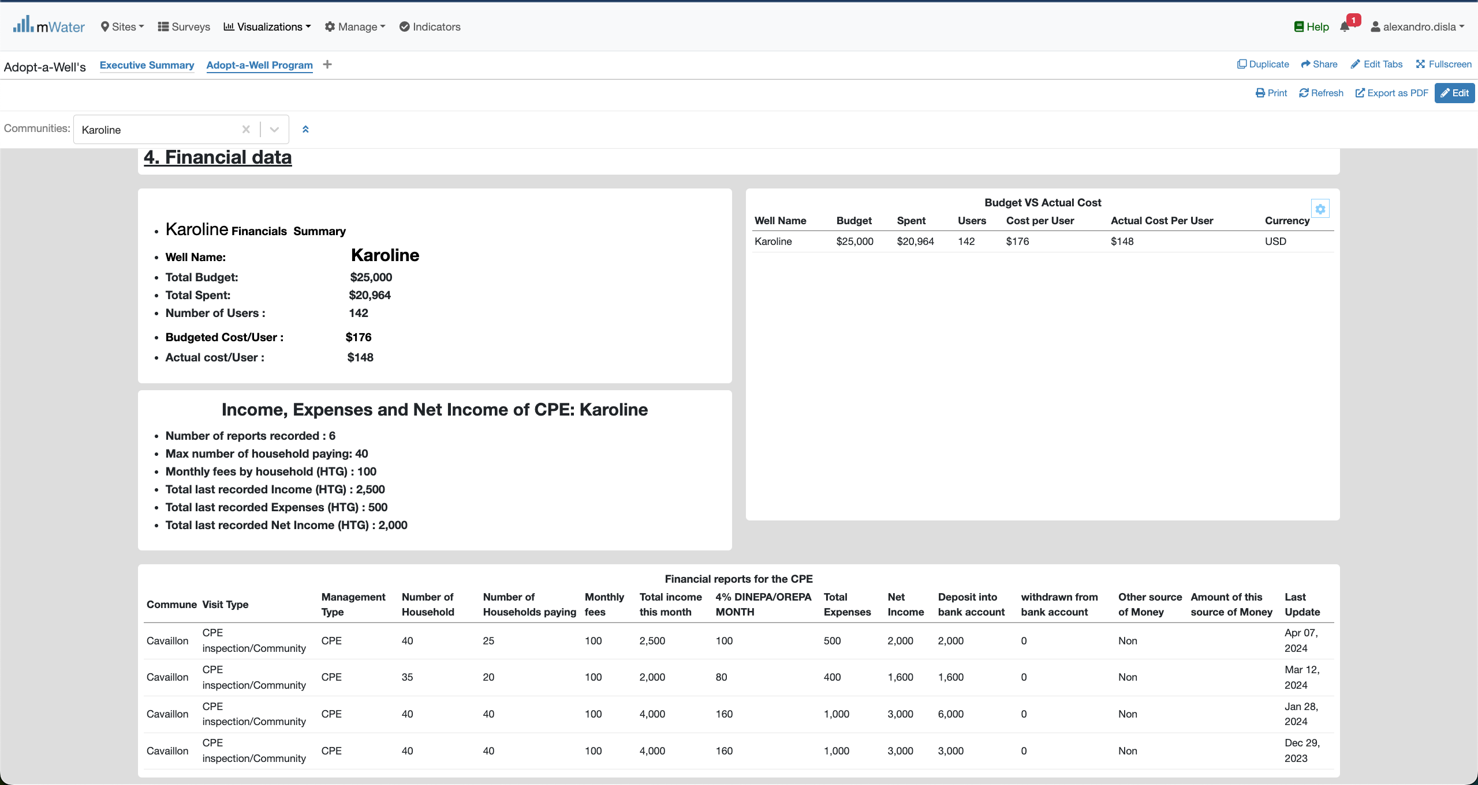
4 SeCtion – Financial
Budget Box Summary
You can click on this line
Data Table

Slide 24
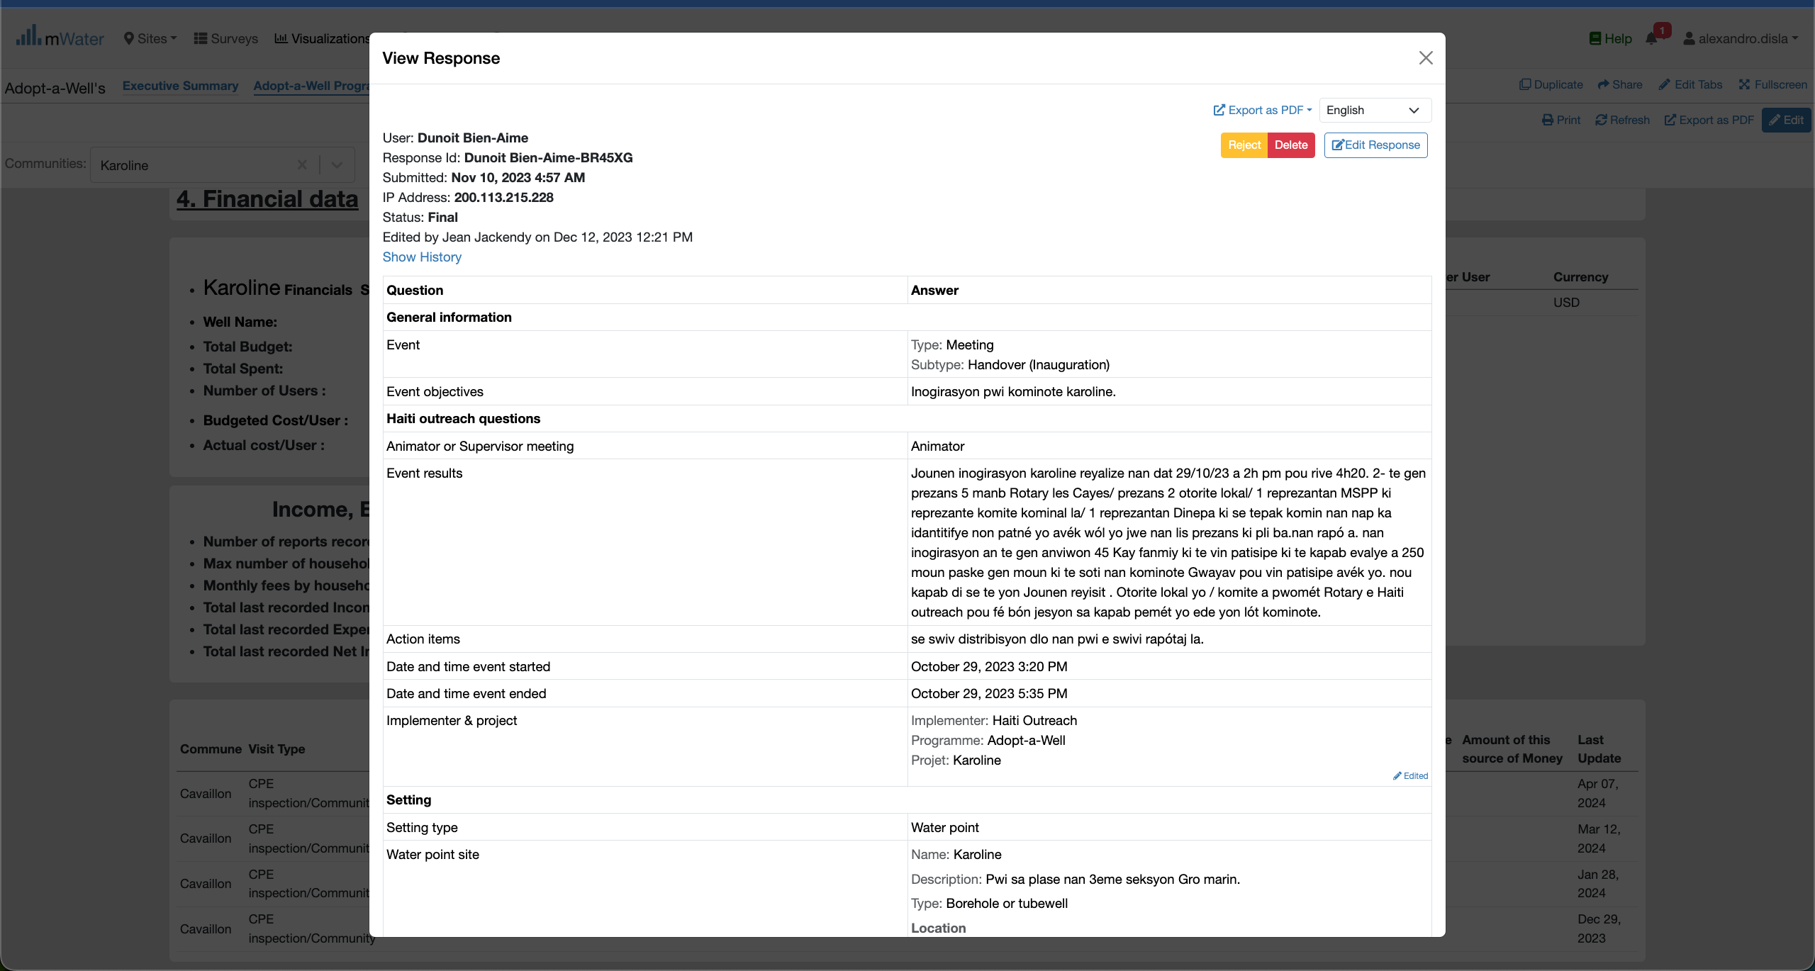
4 SeCtion – Table Interaction

Slide 25
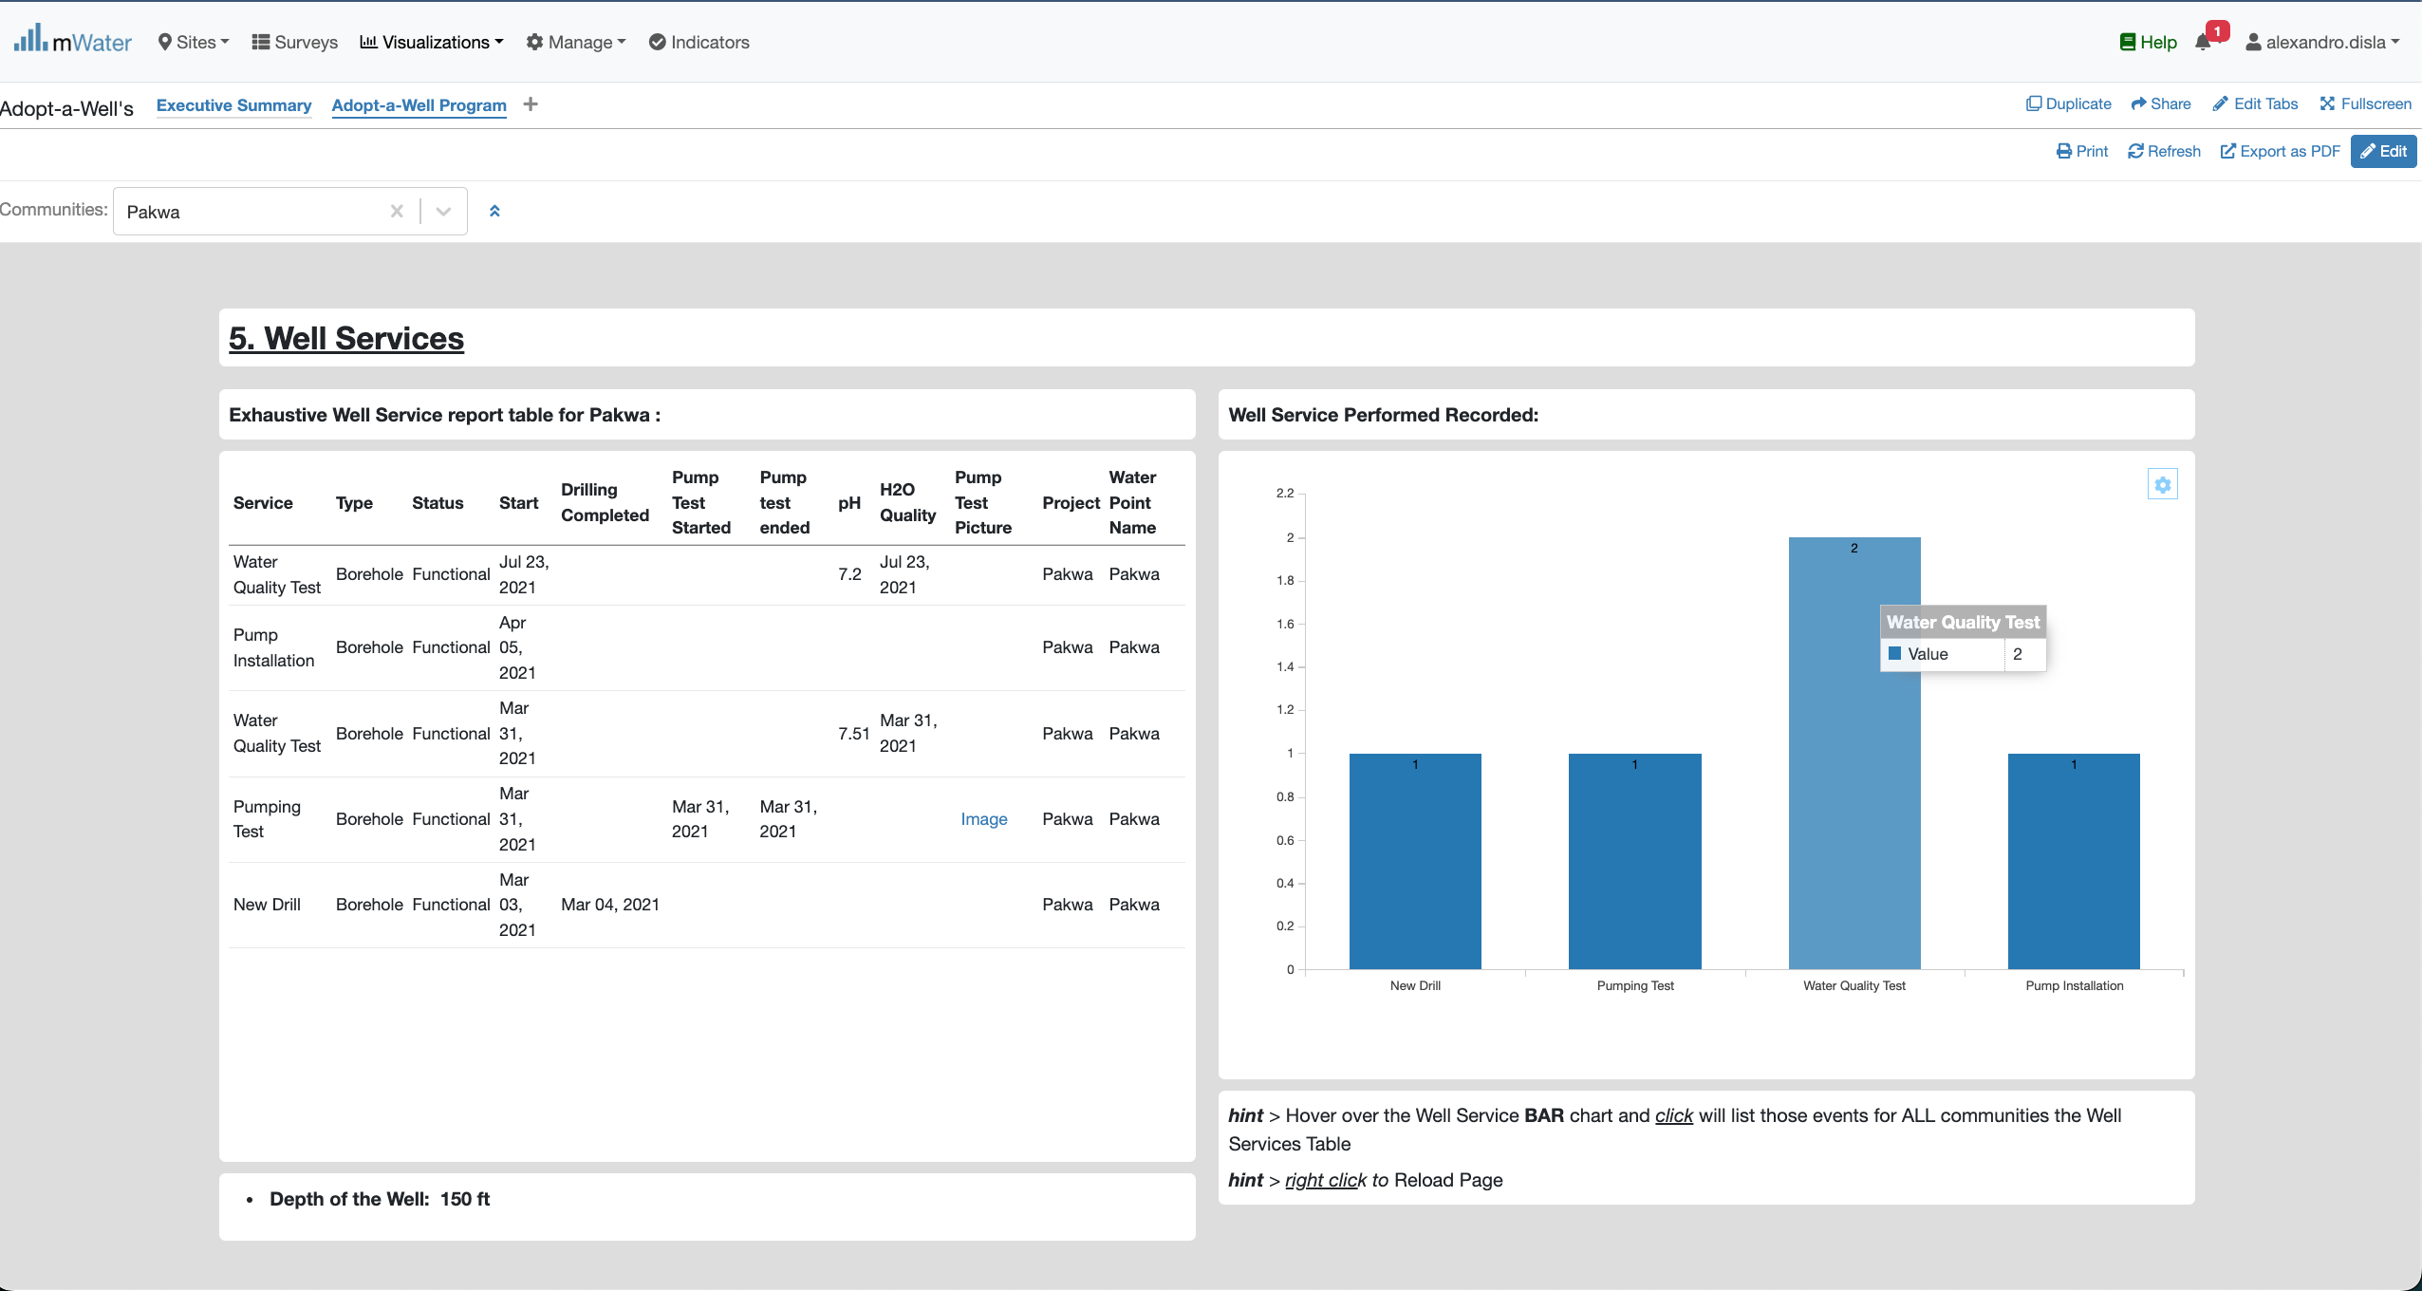
5 SeCtion – Well service
Data Table (click to see a view response)
Bar Chart
Hover effect
A graphic filter will have effect on the table

Slide 26
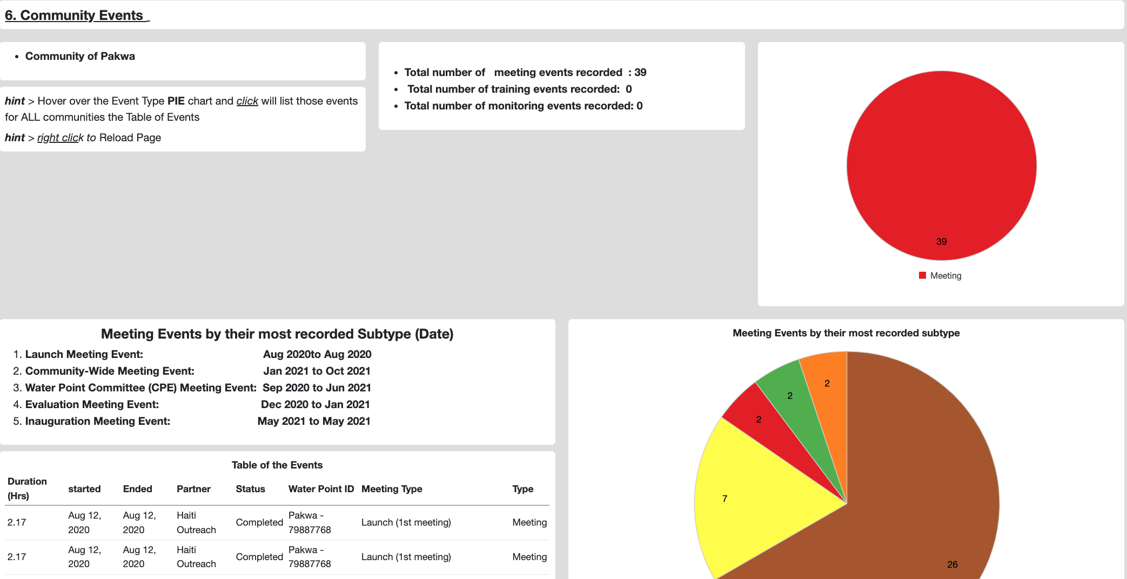
6 SeCtion – Community events
Community: Pakwa
Pie Chart – Mapping the events by their types
Info Box
Data table

Slide 27
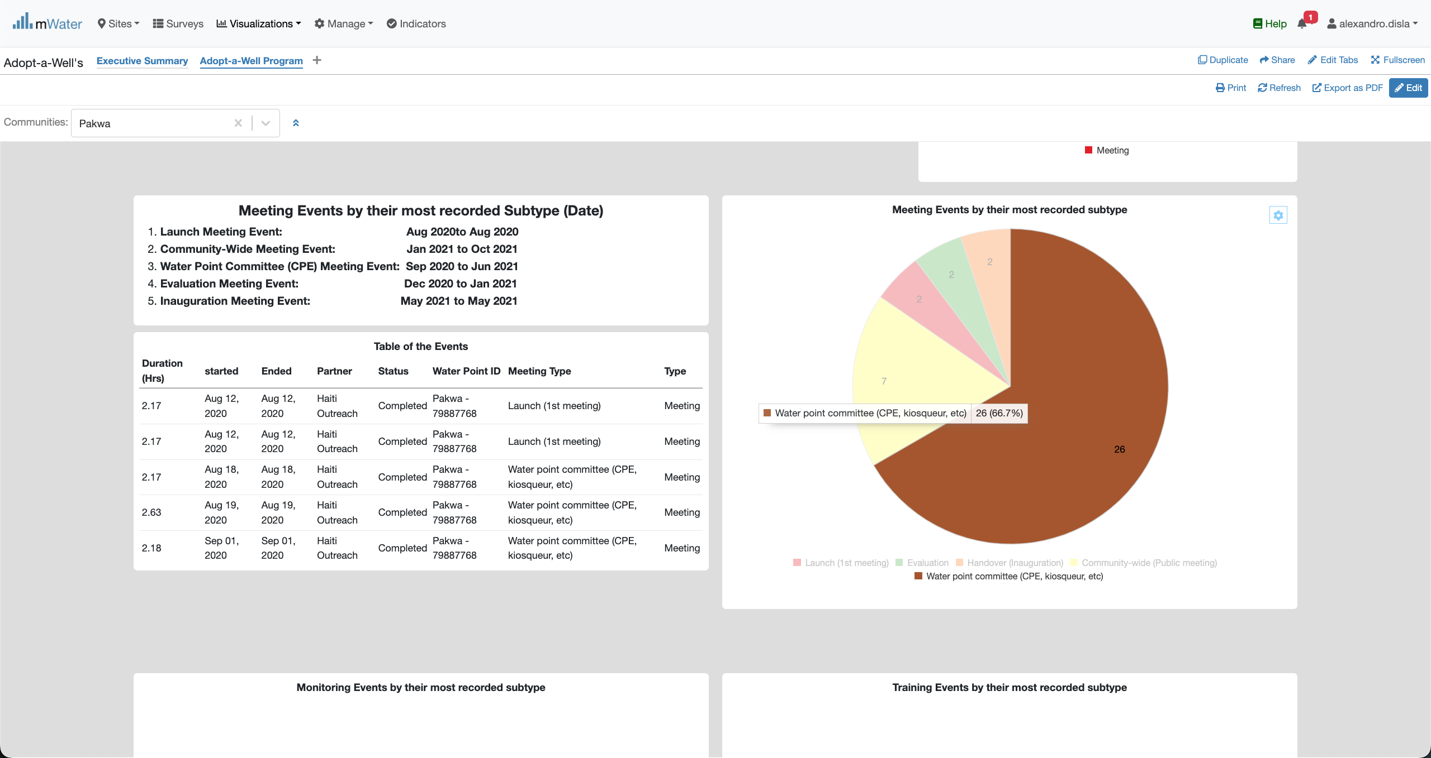
6 SeCtion – Community events (End)
Hover Effect. Filter view available on the pie chart.

